Slide 1
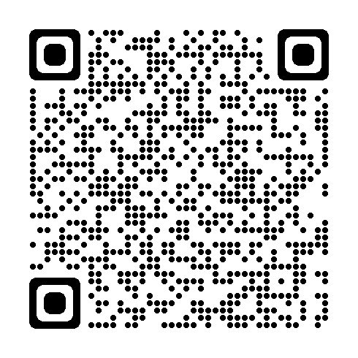
Welcome Biologists!
Please register in the following form. Your registration help us keep sponsoring events like this for you!
http://tinyurl.com/registration-biows

Slide 2


Upfront With
Imposter Syndrome
DIP
&
UDIP
Courtesy of UC Davis Diversity and Inclusion in Physics
& Undergraduate Diversity and Inclusion in Physics
Notes:
Ruth welcomes participants
Annalise & Molly introduce themselves.
Thank UCDavis DIP & UDIP

Slide 3
Guidelines for engagement
Confidentiality
Step forward/step back
Avoid generalizations
Assume best intentions
Respect
Notes:
These guidelines are so everyone feels welcome to engage and comfortable sharing.
– this is a safe environment, so keep what is shared to yourself
give others the chance to talk and speak up if you don’t usually talk
avoid sweeping statements about entire groups of people
assume we are all here to share constructively/don’t assume people have bad intentions when sharing their opinion
respect…

Slide 4
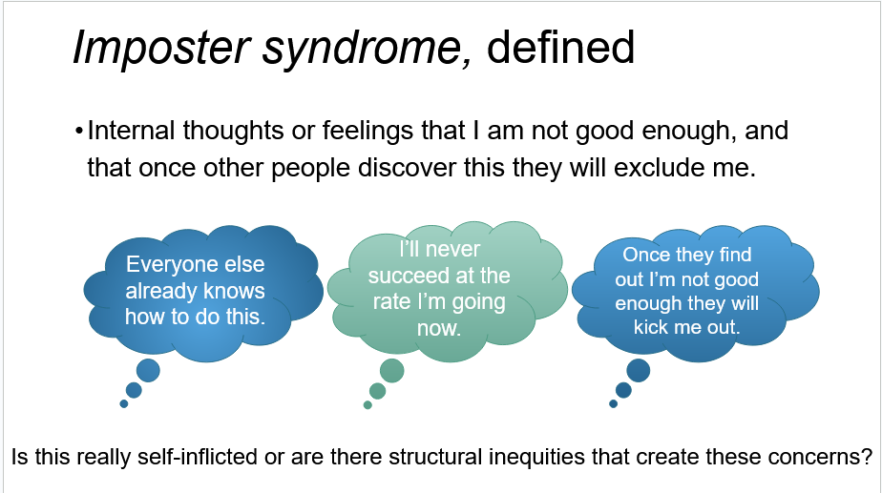
Notes:
These concerns are sometimes projected onto you

Slide 5
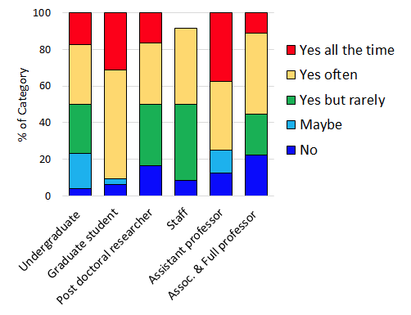
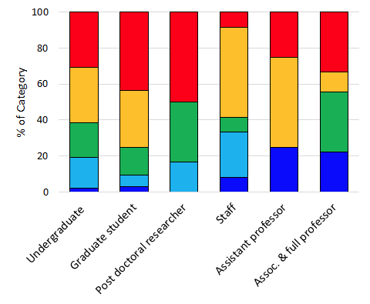
Have you ever felt or been made to feel like you are out of place or unqualified in your professional setting?
Do you worry others will be disappointed if you do not live up to what you feel are mistaken expectations of you?
Notes:
These sentiments are prevalent at all career stages, lots of ups & downs, slightly better at later stages

Slide 6
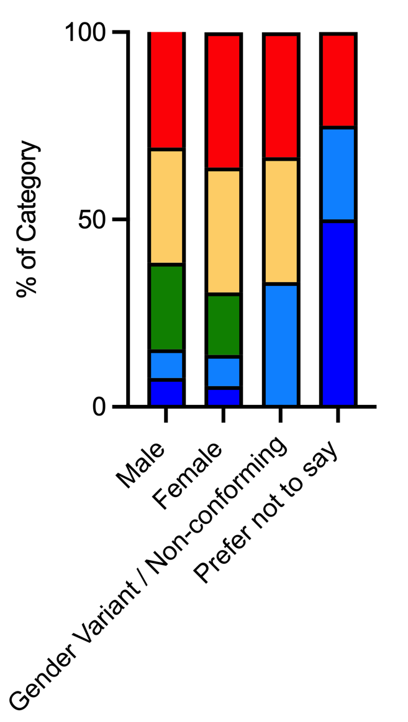
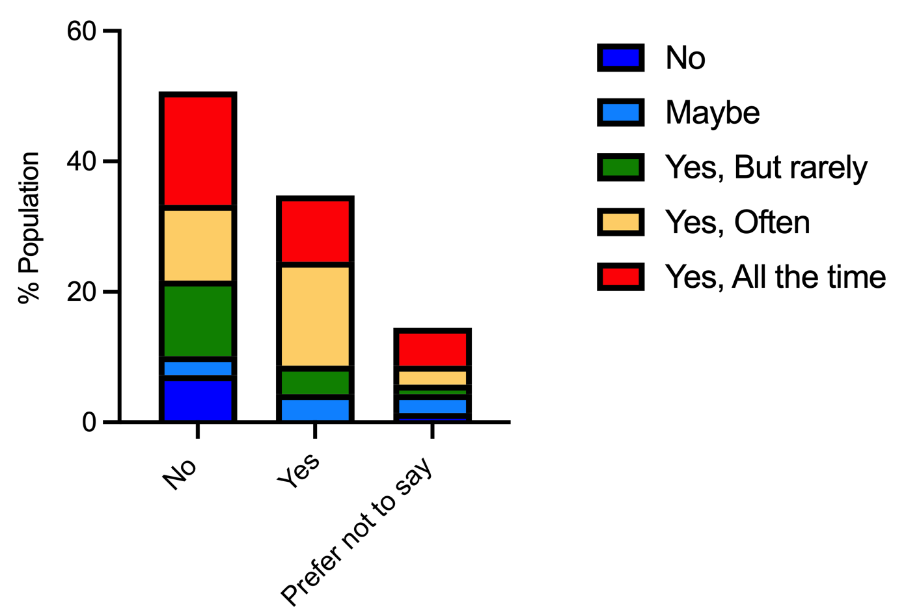
Do you worry that your colleagues or supervisors will be disappointed if you do not live up to what you feel are mistaken expectations of you?
Underrepresented Communities
Notes:
Sentiments also similarly split across gender lines, and whether or not underrepresented

Slide 7
Strategies for stopping
imposter syndrome in its tracks
Set realistic standards
Set realistic standards
  Break tasks down into manageable goals.
  Prepare for mistakes - they are natural.
Prepare for mistakes
Create a mentorship team
  Establish mentorship inside and outside of your work environment.
Minimize comparison
  Honor your own path.
  Be proud of your own growth and achievements.
Know your imposter moments
  Observe imposter thoughts instead of entertaining them.
  Prepare yourself for times and places where you know they arise.
Notes:
prepare for mistakes–they are natural
Growth mindset (defined on next slide–switch order?) doesn’t mean you have to have a 100% positive outlook, but that you can improve.
Recognize when you’re being gaslit

Slide 8

Fixed vs. growth mindsets
Fixed mindset: Belief that success is rooted solely in innate abilities.
Growth mindset: Belief that success is possible through hard work, effective practice, and help from others when needed.
Experience:
Everyone else already knows how to do this.
Fixed mindset response:
They are smarter than me.
Growth mindset response:
Everyone has different levels of experience. If I put in effort, I can learn this.
“An expert is a person who has made all the mistakes that can be made in a very narrow field.” - Niels Bohr

Slide 9

Anonymous testimonies:
1. “I get very nervous before exams; I feel like I am the only one who gets as anxious as I do. It seems like most of my friends just get the material and they don’t have to work as hard as I do. I must be doing something wrong, or maybe I am just bad at this.” - MCDB Undergraduate Student
2. “I have always wanted to be a doctor, but I feel like I will never be able to compete and be successful. I feel like there is simply no way I could even get accepted to a medical school program. I worry about what my teachers and parents will think if can’t get in.” - MCDB Undergraduate Student
3. “After repeated attempts at an experiment continue to fail, I feel like my PI is disappointed in having me as a graduate student. I see how hard my peers are working, and I often feel like I can't put in the same amount of effort or achieve the same great things they do.” - MCDB Graduate Student
4. “English is not my first language, and a colleague of mine constantly ask me to restate my words because he has trouble understanding me, despite that the words he claims he misunderstand are not ambiguous and can be deducted from the context of the conversation. This often occurs during meetings with other colleagues and therefore I feel my opinions are invalidated or undermined. I have witnessed how he does this to other colleagues as well.” - MCDB Faculty
Notes:
Samples from UCSB survey to be distributed to breakout groups for discussion, focusing on generating constructive responses to the issues raised.

Slide 10
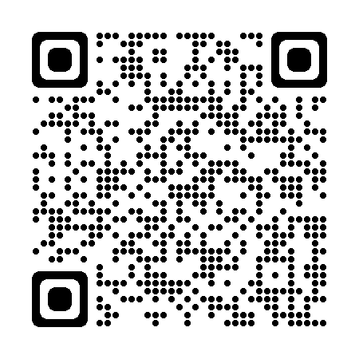
Jamboards
http://tinyurl.com/mcdb-ugrad-ws

Slide 11
Addressing Imposter Syndrome In Our Community
Talk about your own experience
  Normalize conversations around imposter feelings.
Focus on facts
  Point out concrete examples of progress in others.
  Note transitions as these often lead to a rise in imposter feelings.
Create a welcoming community
  We are often made to feel like imposters by others.
  Encourage learning through and from mistakes.
Notes:
Communities can be helpful or harmful—choose well
Research is a process of creating new knowledge–the answers to our questions are not yet known. We need to be comfortable with not knowing the answers, and able to enjoy the excitement of discovery. Some self-questioning is also healthy and essential for good science. Questioning is what we do, and we have to be brave enough to check ourselves…up to a point.
Not one size fits all, some people are more or less comfortable talking about it.

Slide 12
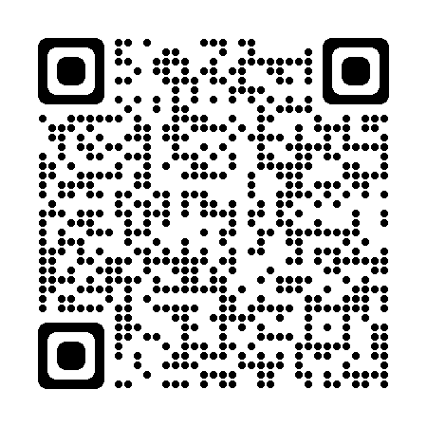
Resources and References
Severe negative thoughts and feelings may benefit from seeking professional help.
Notes:
Resources and References - Google Docs

Slide 13
Thank you to the teams that made this workshop possible!
UC Santa Barbara Team
Molly Kirk
Ruth Finkelstein
Ikuko Smith
Annalise Bond
Erica Rivera
Austin Miller
Sayward Halling
Lalo Gonzalez
UC Berkeley Team
Sunnyjoy Dupuis
Kristi Geiger
Robyn Jasper
Molly Kirk
Peggy Lemaux
Dhruv Patel
UC Davis Team
Rose Baunach
Cassey Chap
Pratik Gandhi
Jessie Hirtenstein
Metzli Montero
Aaron Poletti
Anastasiya Salova
Jenna Samuel
Victoria Strait
Ariadna Venegas Li
Morgan Walker
Notes:
and thanks to all who joined here!

Slide 14
How to get involved in research

Slide 15
Why do you want to do research anyways?
Avoid Checkbox mentality…
Have a personal REAL reason/connection to research
Potential benefits:
  Critical thinking, problem solving, science process, analyze data, complex problems, hand dexterity, team work, follow a protocol, communicate science, etc.

Slide 16
How do you know if you are ready for research?
Do you have good time management?
Are you happy with your grades?
Do you have time for friends/family/yourself?
Do you sleep enough (6 to 8 hrs)?
Do you have 10 – 20 free hours after that?
Are you constantly stressed about deadlines?

Slide 17
Find a Lab that fits you
Area of research
  Skin in / Skin out
Research question(s)?
Techniques / strategies
Keep an open mind
GO TO OFFICE HOURS!
https://www.mcdb.ucsb.edu/research
https://www.eemb.ucsb.edu/research
http://www.duels.ucsb.edu/research/frap/directory
https://www.cnsi.ucsb.edu/research/areas/biotechnology
https://undergrad.research.ucsb.edu/

Slide 18
Do your homework
Find an article in “The current” / other popular science outlets
Explore their webpage
Find and download 2 to 3 articles
  It is ok to not to understand it all
  What is the general question?
  What strategy did they follow?
  Follow the figure story
  What questions do you have?

Slide 19
Write an email
Proper email etiquette for academia
Introduce yourself and how did you find them.
Be concise
Ask specific questions
Ask for an opportunity to learn more about their research
How to Email Your Professor (without being annoying AF) | by Laura Portwood-Stacer | Medium

Slide 20
How long before…?
It is a game of chance
Typically 1 week, then resend the email
If no response within 3 days, then try a Grad student
If no response then move on!

Slide 21
Try the Graduate Students
Grad students are the liaison between you and the PI
In most labs you will be assigned to one of their projects
Make a good impression by being curious, industrious, good work ethics

Slide 22
Opportunities outside UCSB
Summer Research Experiences for Undergraduates (REUs), Summer Internship programs (SIP)
  https://www.nsf.gov/crssprgm/reu/list_result.jsp?unitid=5047
  https://www.niehs.nih.gov/careers/research/summers/index.cfm
  https://www.training.nih.gov/programs/sip
  http://science.energy.gov/wdts/suli/

Slide 23
Myths about joining a lab
You absolutely need to do research while at college
You have to be a genius to get in
You have to know a lot of bio, or have a lot of previous experience
You have to join a lab during your first year… second year… third year…
You will cure cancer (or world hunger, or discover a new subatomic particle…)
You need to come up with your own project
You are stuck in the lab that you joined (even if you did not like it)

Slide 24
Other notes
Look for funding opportunities!
  Eureka, Gorman, MARC, UC LEADS, etc
  http://www.cns.ucsb.edu/undergraduate-summer-research-internships
  http://academics.sa.ucsb.edu/research-funds/gene-lucas-undergraduate-research-fund
Get credit for doing research
  MCDB199, MCDB 184
Each lab is unique in what they expect from you, communication is key

Slide 25
Questions?

